Slide 1


Data analysis and forecasting of Walmart retail data using pyspark and machine learning.

Slide 2
GUIDED BY
Mrs. Trupti Joshi
Mr. Prasad Deshmukh
GROUP MEMBERS
KIRAN THORAT (240343025022)
PAYAL JADHAV (240343025034)
SHUBHAM MULE (240343025056)
MANU SINGH (240343025025)

Slide 3
INTRODUCTION
Business Impact: Use predictions to support critical business operations, including inventory management and pricing strategies.
Technological Approach: Implement and evaluate various machine learning algorithms using PySpark for efficient processing of large datasets.
Data Visualization: Utilize Tableau to create intuitive visualizations that make data insights accessible to stakeholders.
Objective: Provide accurate predictions and actionable insights to drive informed business decisions.

Slide 4
PROBLEM STATEMENT
Sales Analysis: How can we effectively analyze Walmart's historical sales data to identify key trends and patterns that drive business performance and inform decision-making?
Sales Prediction: How can we accurately forecast Walmart's future sales using historical data, accounting for factors like seasonality and promotions, to optimize inventory and pricing strategies?

Slide 5






ARCHITECTURE
Data collection
Data pre-processing
Exploratory data
analysis
Predictions &
Deployment
Data Visualization
Model Training
Clean Data

Slide 6
DATA PRE-PROCESSING
1. Dropping autogenerated Columns
2. Handling Missing Values:
4. Handling Categorical Columns
5. Converting Data Types:
6. Handling Outliers:
7. Adding New Column

Slide 7
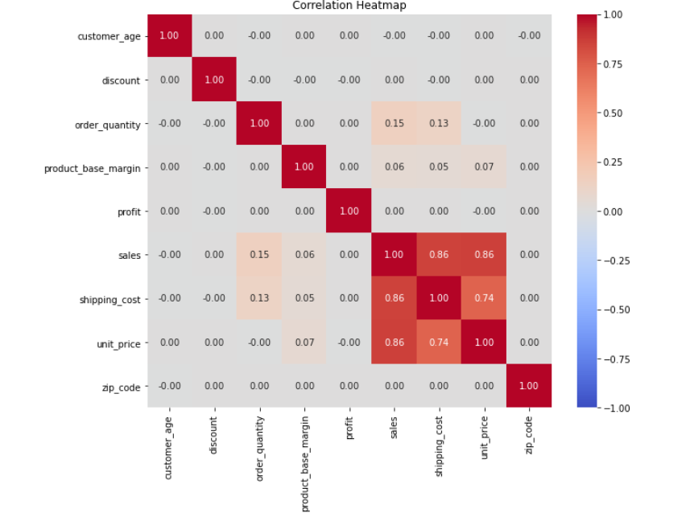
EDA

Slide 8
ML MODELS
Model Selection: Chosen the ARIMA (AutoRegressive Integrated Moving Average) model due to its effectiveness in time series forecasting, particularly for data with trends and seasonality, like Walmart's sales data.
Parameter Tuning: Conducted extensive parameter tuning, including selecting the optimal p (autoregressive order), d (differencing order), and q (moving average order) parameters, to improve the model's accuracy in predicting future sales.
Model Evaluation: Evaluated the ARIMA model's performance using metrics such as Mean Absolute Error (MAE) and Root Mean Square Error (RMSE) to ensure the predictions were reliable and aligned with actual sales trends.

Slide 9
CONCLUSION
Developed accurate sales prediction models that support key business operations like inventory and pricing strategies.
Efficiently processed large datasets using PySpark, ensuring scalability and precision.
3- Delivered actionable insights through Tableau visualizations, enabling data-driven decision-making for stakeholders.

Slide 10
PROBLEM FACED
Data Quality Issues: Encountered inconsistencies and missing values in the historical sales data, requiring significant data cleaning and preprocessing efforts.
Scalability Challenges: Managing and processing the vast volume of sales data posed challenges in terms of computational resources and time efficiency, especially when implementing complex machine learning models.
Model Performance Variability: Achieving consistent prediction accuracy across different stores and time periods was challenging due to factors like seasonality, promotions, and regional differences.

Slide 11
FUTURE SCOPE
1-Model Enhancement: Explore advanced machine learning techniques to improve prediction accuracy.
Incorporating External Data: Integrate additional data sources like economic indicators to refine forecasts.
Real-time Analytics: Develop real-time sales prediction capabilities for dynamic inventory and pricing management.

Slide 12
THANK
YOU

